Slide 1

Air Pollution Levels around different cities and countries
Data Science Project
By:
Yarin Mizrachi
Carmel Isaac

Slide 2
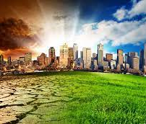


How we got the Idea:
In the beginning we wanted to do project related to entertainment industry, such as music, movies, social media etc.
Due to Covid19 people are with mask. We fear after this pandemic, we still will be with masks due to pollution.
Then we discussed about climate change, environmental pollution affecting many cities and countries.

Slide 3

Our Research:
Can we predict future PM2.5 level by month?
Which countries have the most polluted cities?
Can we recognize something in common with those countries?

Slide 4
Data sources:
Crawling:
https://www.iqair.com/world-most-polluted-cities
Information:
We used the same website to know more about the information and used Wikipedia to read and know more about PM2.5.

Slide 5
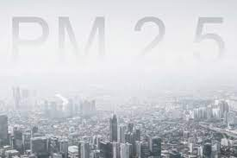
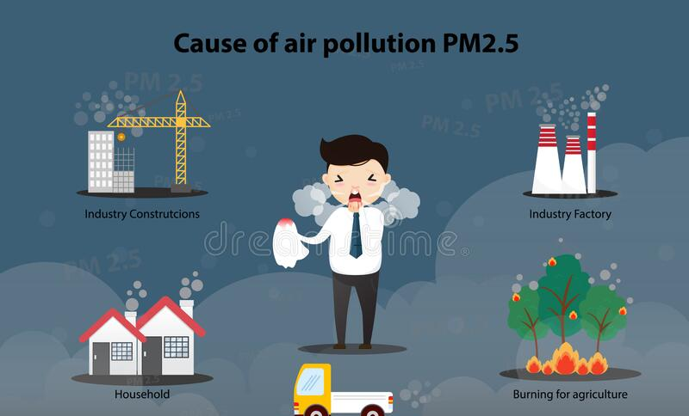
A Little about our Data:
In our project we are measuring the PM2.5 levels throughout the months.
PM = Particulate Matter, refers to particles found in the air, including dust, soot, dirt, smoke, and liquid droplets.

Slide 6

Crawling:
Our first try at crawling was not as we expected, we wanted to crawl from: https://stats.oecd.org/Index.aspx?DataSetCode=CITIES# Though we were careful we got Blocked.

Slide 7

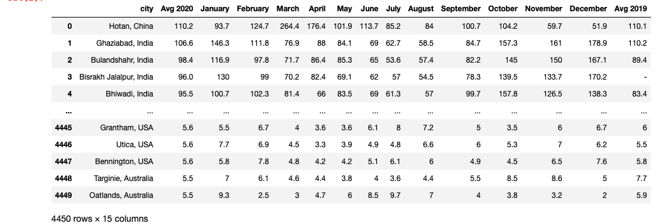
Crawling:
We used ‘BeautifulSoup’ library to crawl.
After crawling and taking all the relvant data the data set we got is:

Slide 8

Data Cleaning:
In our data missing elements were filled with ‘-’, we cleaned the rows that had a missing data.
In addition we added a column called “Classify Groups” that classified to groups ”2020 Avg”
1=Good=10-12
2=Moderate=12.1-35.4
3=Unhealthy for sensitive groups=35.5-55.4
4=Unhealthy=55.5-150.4
5=Very Unhealthy=150.5-250.4

Slide 9
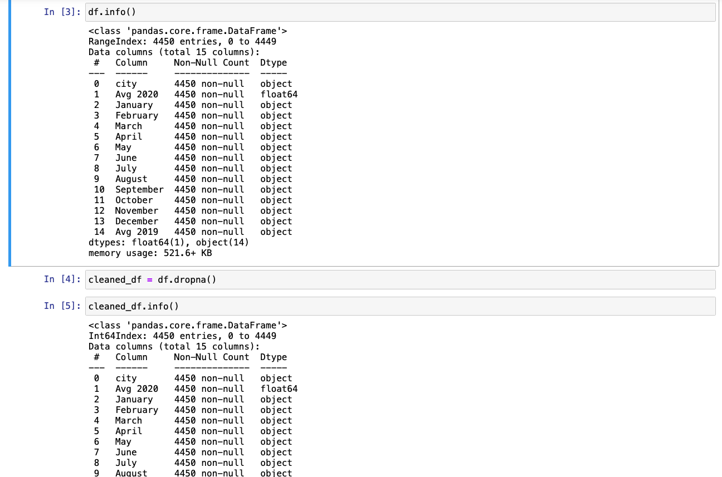
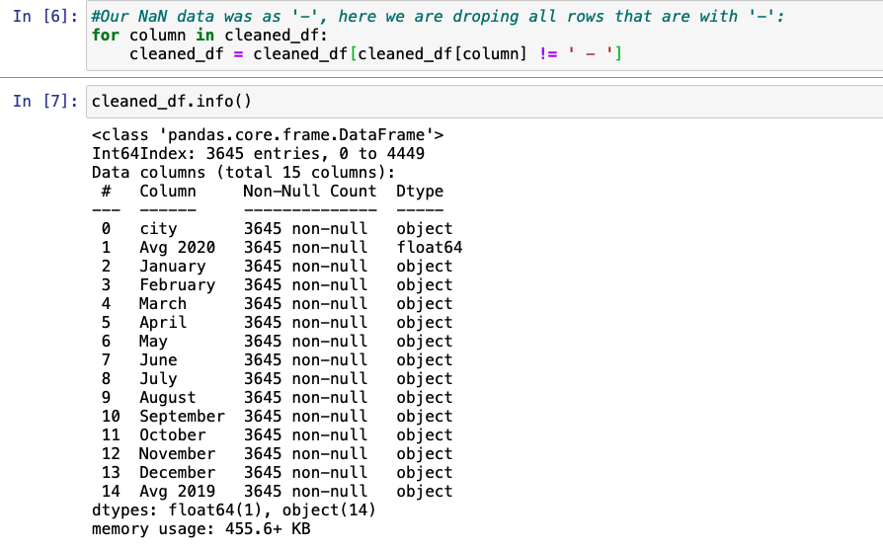
Data Cleaning (continue):

Slide 10
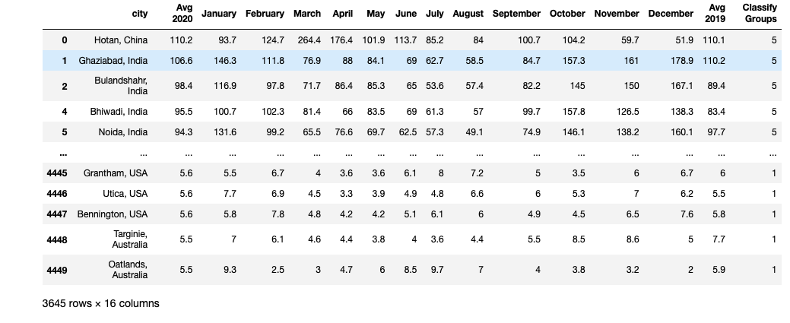
Data Cleaning (continue):

Slide 11
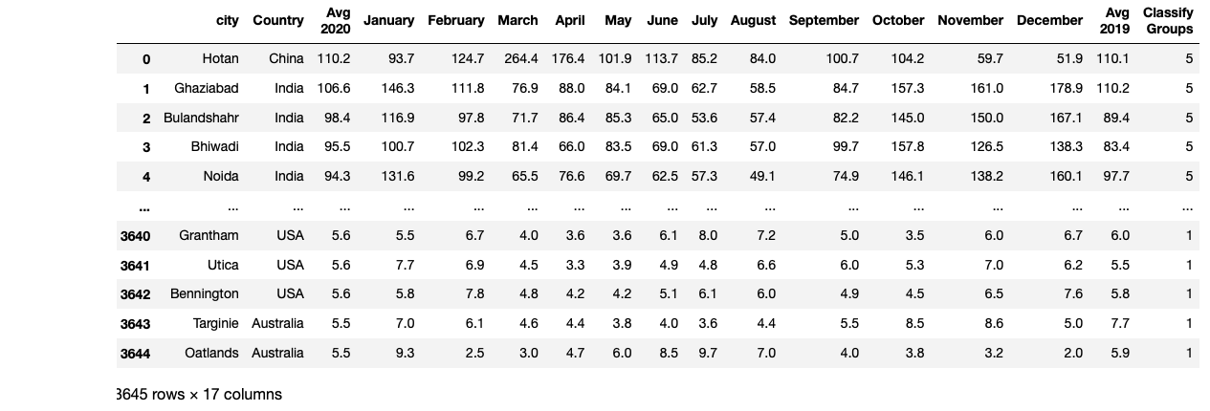
DATA CLEANING (CONTINUE):
We faced a problem as our City and Country was as one column, and to solve this issue, we divided it into two columns i.e. (1) City (2) Country.

Slide 12

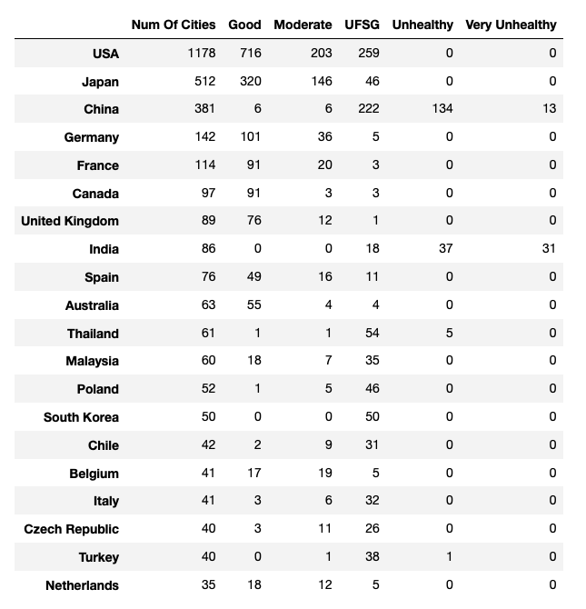
EDA Explatory Data Analysis
To do the visualization we used the “Groupby” function to group by country.
We used several visualization methods to see difference between countries.

Slide 13
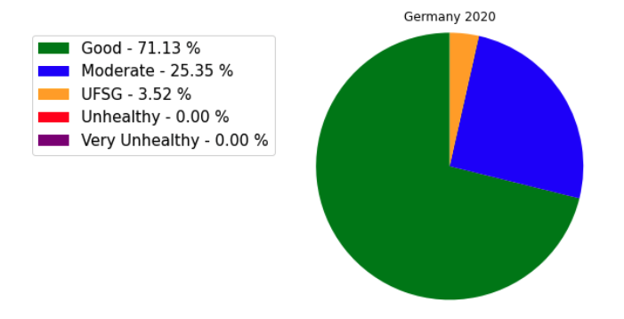
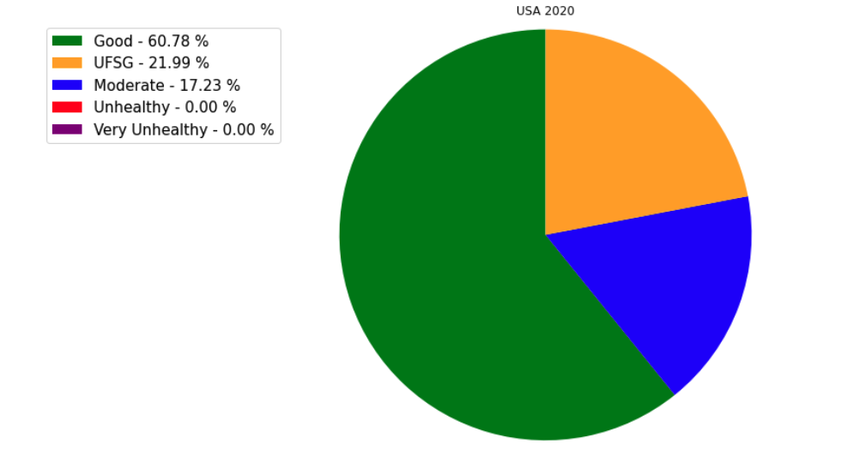
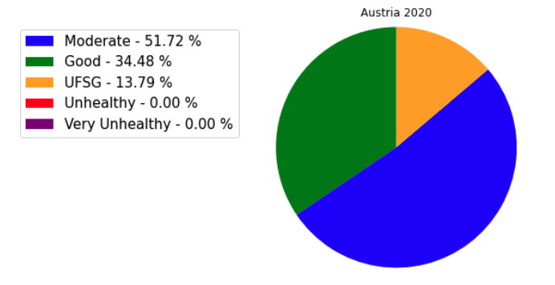
Pie Charts:

Slide 14
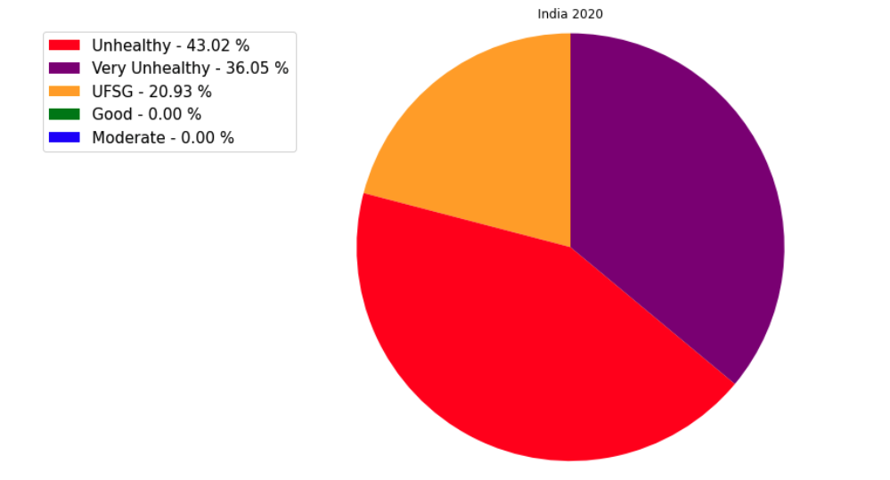
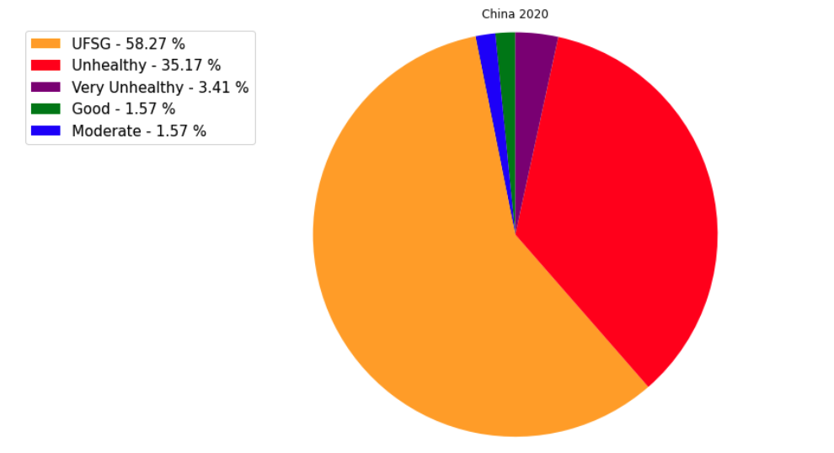
We can see that Asian countries have most polluted cities while European countries mostly free from air pollution.

Slide 15
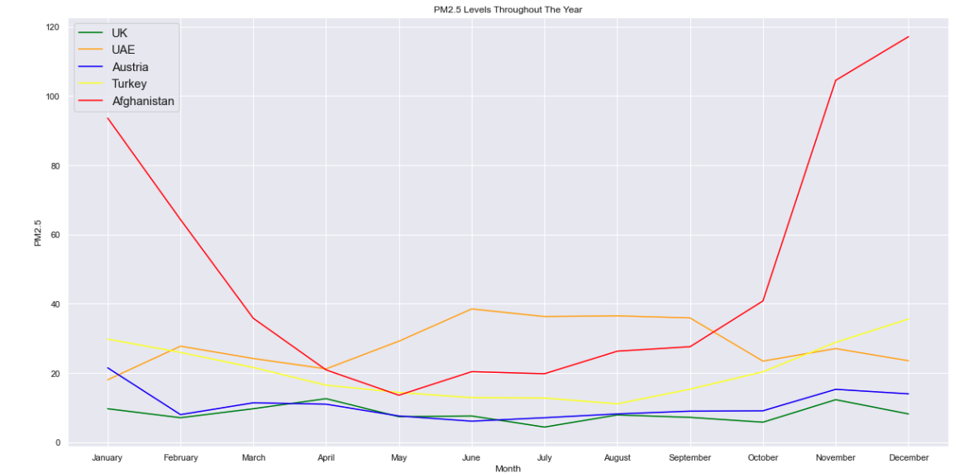
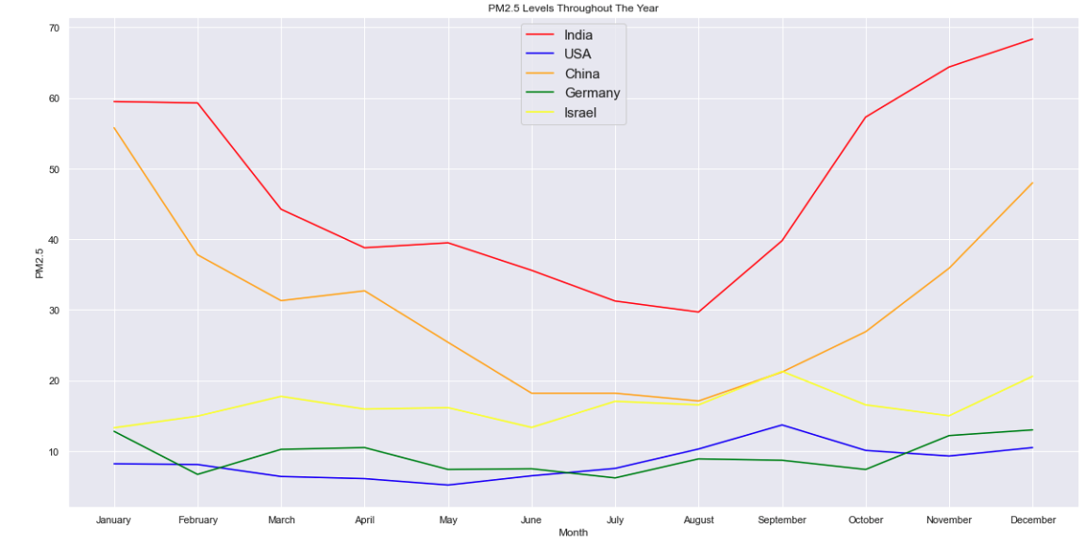
Subplots:
Here we can see each country level according to the months.
We can also see how asian countries have larger level of PM2.5.
Interesting fact:
India’s PM2.5 level increases in October November during ‘Diwali’ festival that is known for firing crackers, one of the main reason that causes pollution.

Slide 16
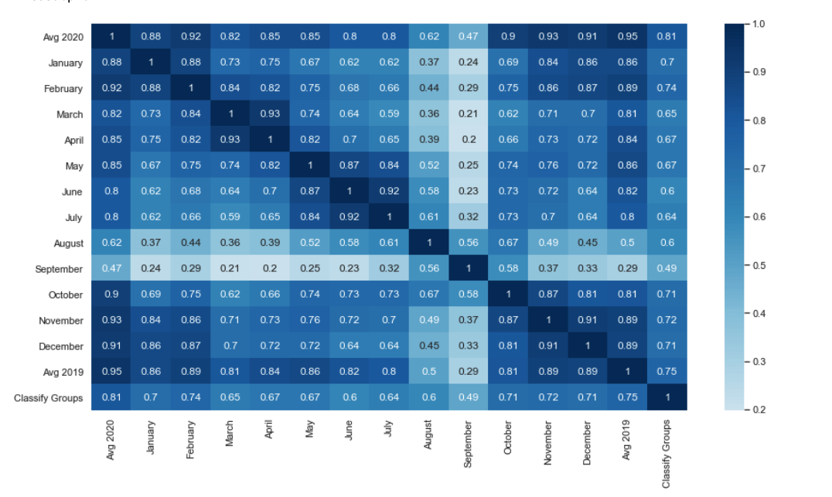
Heat map:
In our heatmap we can see that all our variabels have positive correlation with each other.

Slide 17
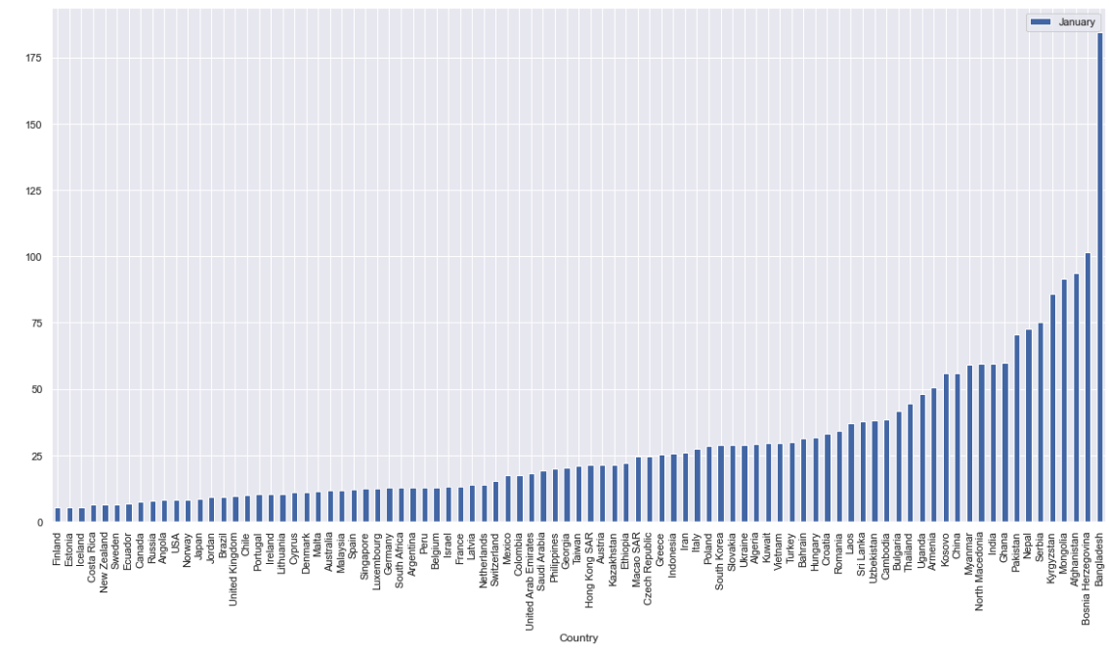
Bar plots:

Slide 18
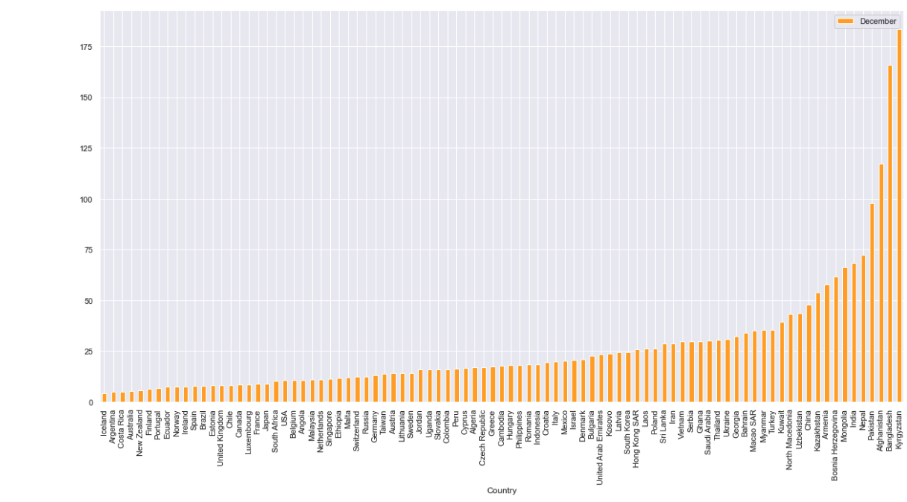
Bar plots:

Slide 19

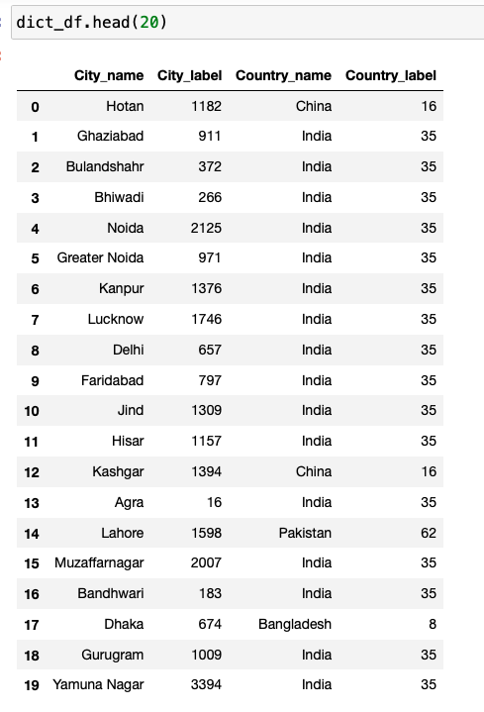
Machine Learning:
Before starting to create our ML model we created a dictionary to see which code every city and country gets using “LabelEncoder”.
We created a Decision tree regressor model:
A decision tree is a complete binary tree consisting of decision nodes in each of which a particular condition is tested on a particular characteristic of the observations and leaves that contain the predicted value for the observation corresponding to the path leading to them in the tree.

Slide 20
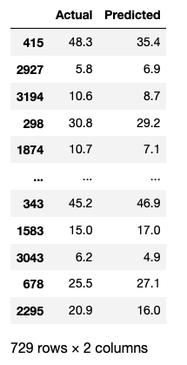
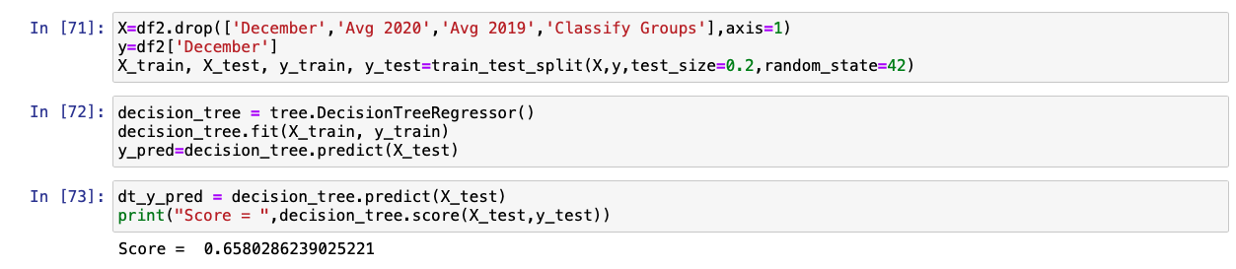
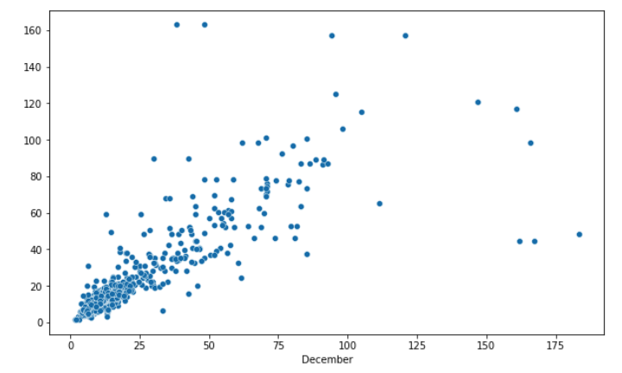
Decision Tree Model:
This model gave us a score of 0.65, so we decided to create another model, Linear regression model.

Slide 21
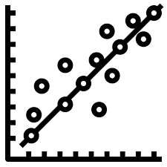
Linear Regression:
Linear Regression is a machine learning algorithm based on supervised learning. It performs a regression task. Regression models a target prediction value based on independent variables.
We measured our model by:
R2 score – one of the performance evaluation measures for regression-based machine learning models.
MAE - Absolute Error is amount of error in your measurements.
MSE - The mean squared error tells you how close a regression line is to a set of points.

Slide 22
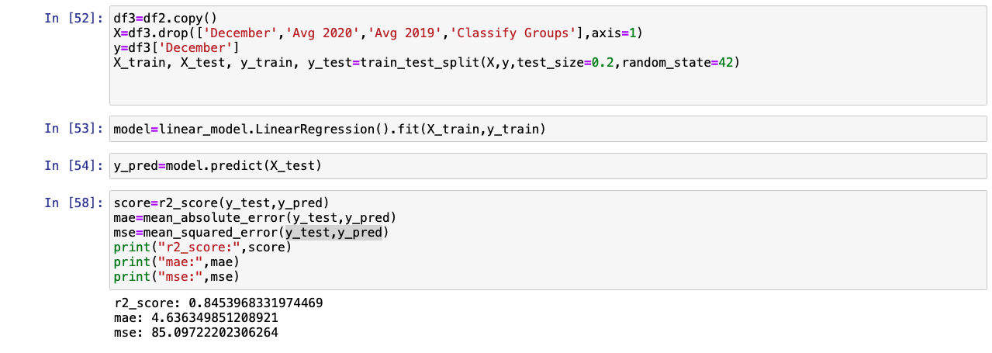
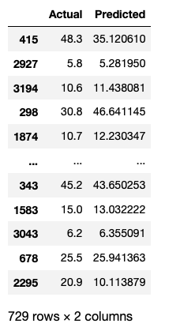
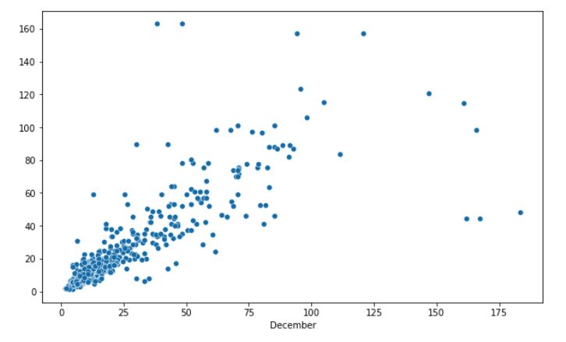
Linear Regression:

Slide 23

Conclusions:
In our project we got to see from our visualization that Asian countries have the most polluted cities around the world.
We succeeded to predict the next month PM2.5 value for our project.
We also think that this project can be expanded more because this subject has lots of information and we think there is lots of future prediction possibilities.

Slide 24



